Slide 1
GUI Basics
First three slides are repeated from previous lecture notes!
You will probably (in fact should) never write Java codes like the program examples given in these notes. You will use IDEs (integrated development environment / integrated design environment / integrated debugging environment) like Netbeans, Eclipse JDT, Kdeveloper etc. to design / develope / test GUIs.
Java codes given in these notes are for reference, understanding the underlying workings and design of Java GUI API, introducing key concepts, naming convensions and key terms , which you must know for sure to learn and practice in Java GUI API.
Key Terms: GUI, API, Swing, Component, Container, JFrame, JPanel, LayoutManager, GUI Helper Classes, Swing GUI Components (JButton, JTextField, JLabel, JComboBox, J...) , Common Features

Slide 2
The Java API
The Java API (Application Program Interface, Application Programming Interface, or Application Programmer interface) consists of numerous classes and interfaces grouped into more than a dozen of packages. You have used classes and interfaces in the java.lang, javax.swing, and java.util packages.

Slide 3
Framework-Based Programming
To create comprehensive projects, you have to use more classes and interfaces in the Java API. The classes and interfaces in the Java API establish a framework for programmers to develop applications using Java. For example, the classes and interfaces in the Java GUI API establish a framework for developing GUI programs. You have to use these classes and interfaces and follow their conventions and rules to create applications. This is referred to as framework-based programming.

Slide 4
Framework-Based Programming, cont.
Once you understand the concept of Java and object-orient programming, the most important lesson from now on is learning how to use the API to develop useful programs. The most effective way to achieve it is to imitate good examples. The book provides many carefully designed examples to demonstrate the concept of the framework-based programming using the Java API.

Slide 5
Motivations
The design of the API for Java GUI programming is an excellent example of how the object-oriented principle is applied. In the chapters that follow, you will learn the framework of Java GUI API and use the GUI components to develop user-friendly interfaces for applications and applets.

Slide 6
Objectives
To distinguish between Swing and AWT.
To describe the Java GUI API hierarchy.
To create user interfaces using frames, panels, and simple GUI components.
To understand the role of layout managers.
To use the FlowLayout, GridLayout, and BorderLayout managers to layout components in a container.
To use JPanel as subcontainers.
To specify colors and fonts using the Color and Font classes.
To apply common features such as borders, tool tips, fonts, and colors on Swing components.
To use borders to visually group user-interface components.
To create image icons using the ImageIcon class.

Slide 7
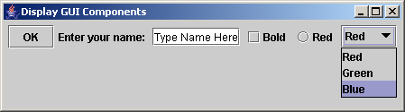
Creating GUI Objects
// Create a button with text OK
JButton jbtOK = new JButton("OK");
// Create a label with text "Enter your name: "
JLabel jlblName = new JLabel("Enter your name: ");
// Create a text field with text "Type Name Here"
JTextField jtfName = new JTextField("Type Name Here");
// Create a check box with text bold
JCheckBox jchkBold = new JCheckBox("Bold");
// Create a radio button with text red
JRadioButton jrbRed = new JRadioButton("Red");
// Create a combo box with choices red, green, and blue
JComboBox jcboColor = new JComboBox(new String[]{"Red",
"Green", "Blue"});
Label
Text field
Check Box
Radio Button
Button
Combo Box

Slide 8
Swing vs. AWT
So why do the GUI component classes have a prefix J? Instead of JButton, why not name it simply Button? In fact, there is a class already named Button in the java.awt package.
When Java was introduced, the GUI classes were bundled in a library known as the Abstract Windows Toolkit (AWT). For every platform on which Java runs, the AWT components are automatically mapped to the platform-specific components through their respective agents, known as peers. AWT is fine for developing simple graphical user interfaces, but not for developing comprehensive GUI projects. Besides, AWT is prone to platform-specific bugs because its peer-based approach relies heavily on the underlying platform. With the release of Java 2, the AWT user-interface components were replaced by a more robust, versatile, and flexible library known as Swing components. Swing components are painted directly on canvases using Java code, except for components that are subclasses of java.awt.Window or java.awt.Panel, which must be drawn using native GUI on a specific platform. Swing components are less dependent on the target platform and use less of the native GUI resource. For this reason, Swing components that don’t rely on native GUI are referred to as lightweight components, and AWT components are referred to as heavyweight components.

Slide 9
MVC Connection
A swing component is a composite of 3 aspects.
Model – the state information associated with component.
View – the way how the component looks when rendering on the screen.
Controller – the way how component reacts to the user.
Swing – modified version of MVC – Model Delegate architecture or Separable Model architecture. (UI delegate – View+Controller)

Slide 10
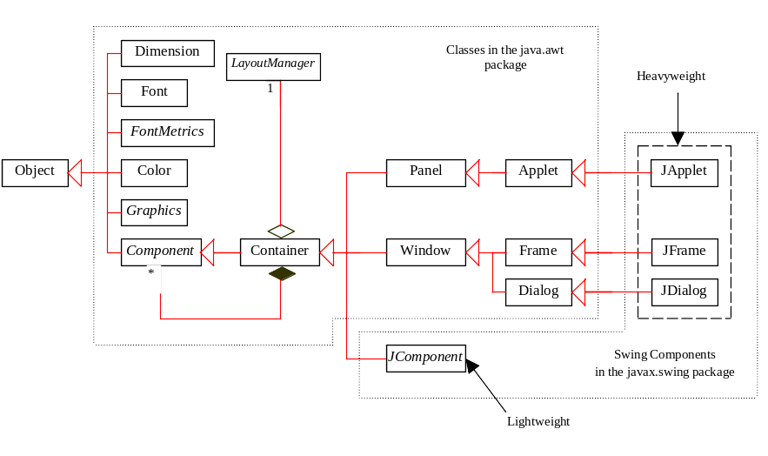
GUI Class Hierarchy (Swing)

Slide 11
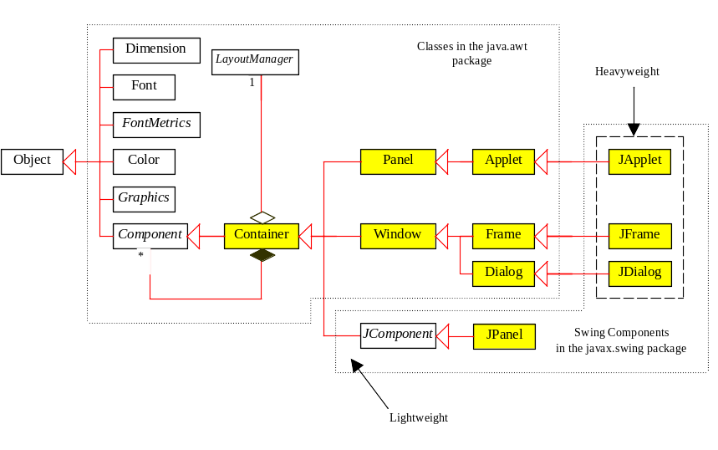
Container Classes
Container classes can contain other GUI components.

Slide 12
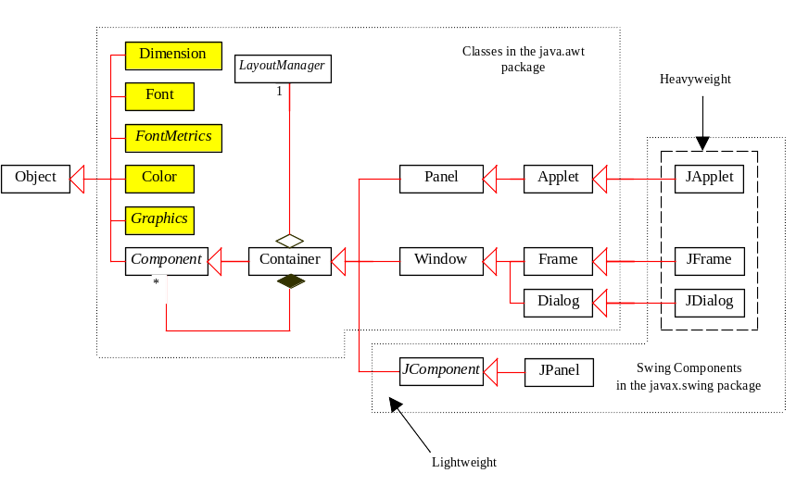
GUI Helper Classes
The helper classes are not subclasses of Component. They are used to describe the properties of GUI components such as graphics context, colors, fonts, and dimension.

Slide 13
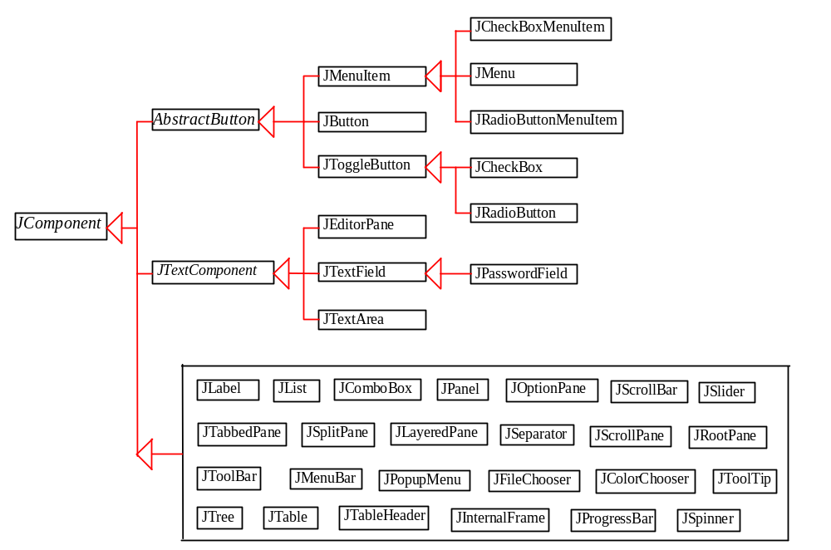
Swing GUI Components

Slide 14
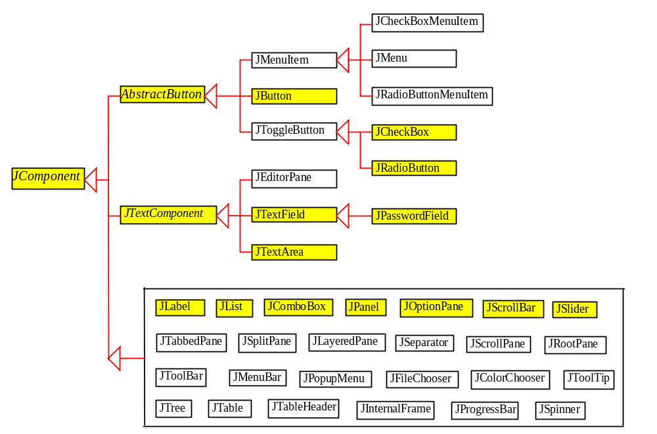
Components Covered in the Brief Version

Slide 15
Top –Level Container Panes (layers)
Root Pane – JRootPane class – light weight container – manage other panes
Layered Pane – JLayeredPane class – allows components to be given a depth value.(Z order) – holds content pane
Content Pane – JPanel class – add visual components.
Glass Pane – JPanel class – manage mouse events or to paint over any other component

Slide 16
Frames
Frame is a window that is not contained inside another window. Frame is the basis to contain other user interface components in Java GUI applications.
The JFrame class can be used to create windows.
For Swing GUI programs, use JFrame class to create widows.

Slide 17
Creating Frames
  import javax.swing.*;
  public class MyFrame {
  public static void main(String[] args) {
  JFrame frame = new JFrame("Test Frame");
  frame.setSize(400, 300);
  frame.setVisible(true);
  frame.setDefaultCloseOperation(
  JFrame.EXIT_ON_CLOSE);
  }
}
MyFrame
Run

Slide 18
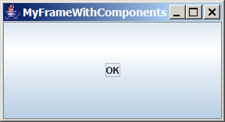
Adding Components into a Frame
// Add a button into the frame
frame.getContentPane().add(
new JButton("OK"));
Title bar
Content pane
MyFrameWithComponents
Run

Slide 19
Content Pane Delegation in JDK 1.5
// Add a button into the frame
frame.getContentPane().add(
new JButton("OK"));
Title bar
// Add a button into the frame
frame.add(
new JButton("OK"));
Content pane

Slide 20
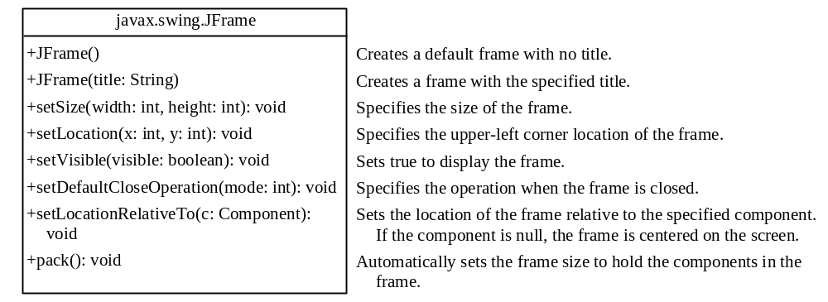
JFrame Class

Slide 21
Layout Managers
Java’s layout managers provide a level of abstraction to automatically map your user interface on all window systems.
The UI components are placed in containers. Each container has a layout manager to arrange the UI components within the container.
Layout managers are set in containers using the setLayout(LayoutManager) method in a container.

Slide 22
Kinds of Layout Managers
FlowLayout
GridLayout
GridBagLAyout
BorderLayout
CardLayout

Slide 23
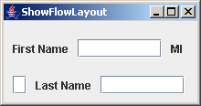
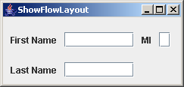
FlowLayout Example
Write a program that adds three labels and text fields into the content pane of a frame with a FlowLayout manager.
ShowFlowLayout
Run

Slide 24
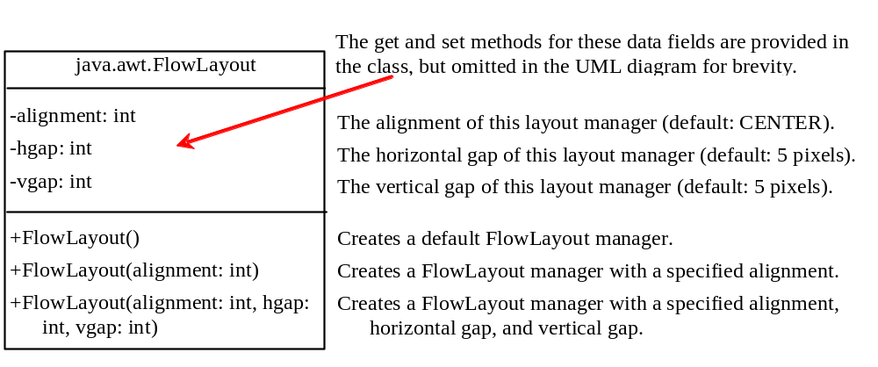
The FlowLayout Class

Slide 25
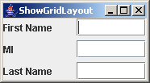
GridLayout Example
Rewrite the program in the preceding example using a GridLayout manager instead of a FlowLayout manager to display the labels and text fields.
ShowGridLayout
Run

Slide 26
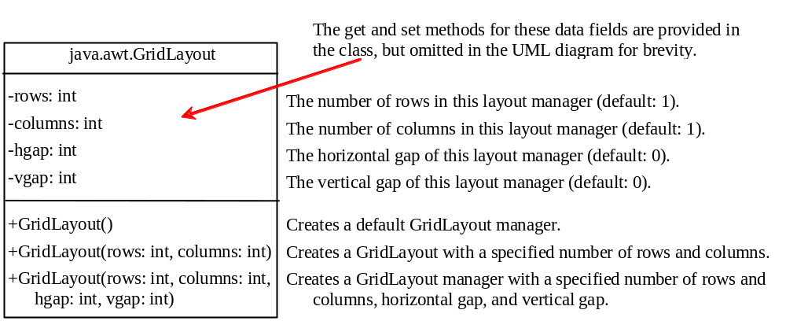
The GridLayout Class

Slide 27
The BorderLayout Manager
The BorderLayout manager divides the container into five areas: East, South, West, North, and Center. Components are added to a BorderLayout by using the add method.
add(Component, constraint), where constraint is BorderLayout.EAST, BorderLayout.SOUTH, BorderLayout.WEST, BorderLayout.NORTH, or BorderLayout.CENTER.

Slide 28
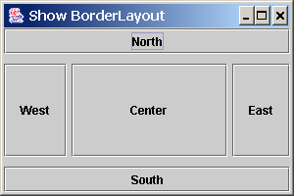
BorderLayout Example
ShowBorderLayout
Run

Slide 29
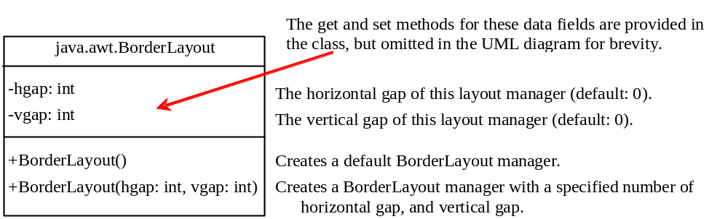
The BorderLayout Class

Slide 30
The Color Class
You can set colors for GUI components by using the java.awt.Color class. Colors are made of red, green, and blue components, each of which is represented by a byte value that describes its intensity, ranging from 0 (darkest shade) to 255 (lightest shade). This is known as the RGB model.
  Color c = new Color(r, g, b);
r, g, and b specify a color by its red, green, and blue components.
Example:
  Color c = new Color(228, 100, 255);

Slide 31
Standard Colors
Thirteen standard colors (black, blue, cyan, darkGray, gray, green, lightGray, magenta, orange, pink, red, white, yellow) are defined as constants in java.awt.Color.
The standard color names are constants, but they are named as variables with lowercase for the first word and uppercase for the first letters of subsequent words. Thus the color names violate the Java naming convention. Since JDK 1.4, you can also use the new constants: BLACK, BLUE, CYAN, DARK_GRAY, GRAY, GREEN, LIGHT_GRAY, MAGENTA, ORANGE, PINK, RED, WHITE, and YELLOW.

Slide 32
Setting Colors
You can use the following methods to set the component’s background and foreground colors:
  setBackground(Color c)
  setForeground(Color c)
Example:
  jbt.setBackground(Color.yellow);
  jbt.setForeground(Color.red);

Slide 33
The Font Class
Font Names
  Standard font names that are supported in all platforms are: SansSerif, Serif, Monospaced, Dialog, or DialogInput.
Font Style
  Font.PLAIN (0), Font.BOLD (1), Font.ITALIC (2), and Font.BOLD + Font.ITALIC (3)
Font myFont = new Font(name, style, size);
Example:
  Font myFont = new Font("SansSerif ", Font.BOLD, 16);
  Font myFont = new Font("Serif", Font.BOLD+Font.ITALIC, 12);
  JButton jbtOK = new JButton("OK“);
  jbtOK.setFont(myFont);

Slide 34
Finding All Available Font Names
GraphicsEnvironment e =
GraphicsEnvironment.getLocalGraphicsEnvironment();
String[] fontnames = e.getAvailableFontFamilyNames();
for (int i = 0; i < fontnames.length; i++)
System.out.println(fontnames[i]);

Slide 35
Using Panels as Sub-Containers
Panels act as sub-containers for grouping user interface components.
It is recommended that you place the user interface components in panels and place the panels in a frame. You can also place panels in a panel.
To add a component to JFrame, you actually add it to the content pane of JFrame. To add a component to a panel, you add it directly to the panel using the add method.

Slide 36
Creating a JPanel
You can use new JPanel() to create a panel with a default FlowLayout manager or new JPanel(LayoutManager) to create a panel with the specified layout manager. Use the add(Component) method to add a component to the panel. For example,
JPanel p = new JPanel();
p.add(new JButton("OK"));

Slide 37
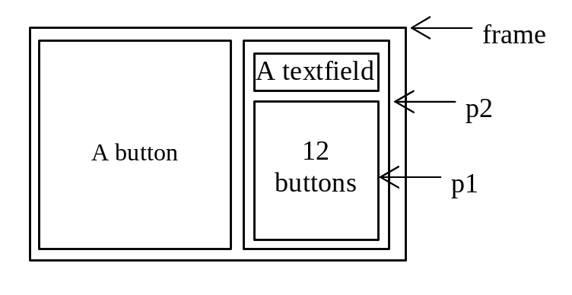
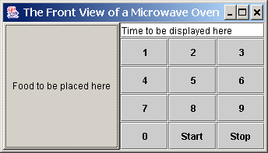
Testing Panels Example
This example uses panels to organize components. The program creates a user interface for a Microwave oven.
TestPanels
Run

Slide 38
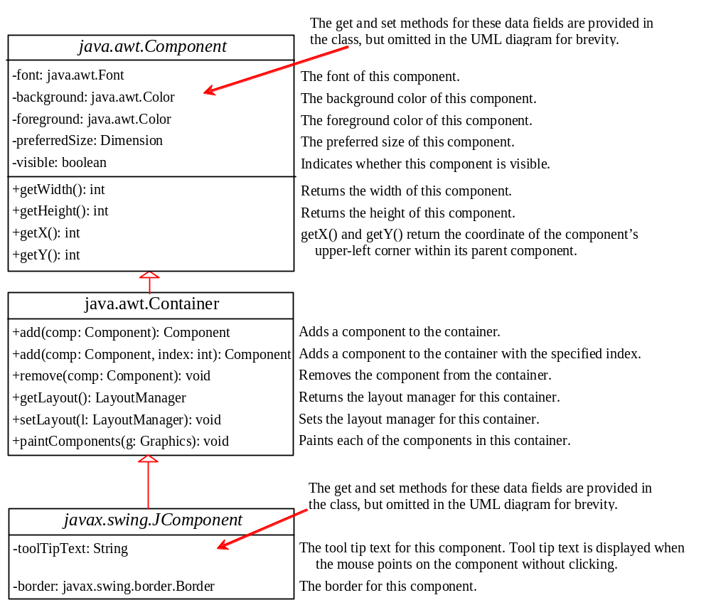
Common Features of Swing Components

Slide 39
Borders
You can set a border on any object of the JComponent class. Swing has several types of borders. To create a titled border, use
  new TitledBorder(String title).
To create a line border, use
  new LineBorder(Color color, int width),
where width specifies the thickness of the line. For example, the following code displays a titled border on a panel:
  JPanel panel = new JPanel();
  panel.setBorder(new TitleBorder(“My Panel”));

Slide 40
Test Swing Common Features
Component Properties
font
background
foreground
preferredSize
minimumSize
maximumSize
JComponent Properties
toolTipText
border
TestSwingCommonFeatures
Run

Slide 41
Image Icons
Java uses the javax.swing.ImageIcon class to represent an icon. An icon is a fixed-size picture; typically it is small and used to decorate components. Images are normally stored in image files. You can use new ImageIcon(filename) to construct an image icon. For example, the following statement creates an icon from an image file us.gif in the image directory under the current class path:
ImageIcon icon = new ImageIcon("image/us.gif");
TestImageIcon
Run

Slide 42
Splash Screen
A splash screen is an image that is displayed while the application is starting up. If your program takes a long time to load, you may display a splash screen to alert the user. For example, the following command:
  java –splash:image/us.gf TestImageIcon
displays an image while the program TestImageIcon is being loaded.

